Slide 1
2. Digital Images, Pixels, Resolution, and Image Formation
By Dr. Nyatega C.O

Slide 2

2.1 What is a digital image?
A digital image is a matrix of numbers. Each number corresponds to one pixel.
Example: $\begin{matrix}12 & 15 & 20 \\ 30 & 60 & 90 \\ 120 & 180 & 255\end{matrix}$​
Each entry is a pixel intensity.
2.2 Pixel
A pixel is the smallest addressable unit in an image. In grayscale:
0 = black
255 = white for 8-bit images

Slide 3

2.3 Spatial resolution
Spatial resolution refers to the number of pixels used to represent the image. Higher resolution means more detail.
Example:
256 × 256 image
1024 × 1024 image
The second generally preserves more fine structures
2.4 Intensity resolution
Intensity resolution refers to the number of gray levels. For an 8-bit image:
${ 2}^{8}=256$levels are available.
For a 4-bit image:
$2^{4}=16$levels are available.levels only.

Slide 4

2.5 Neighbor relationships
For pixel p(x,y), neighbors include:
4-neighbors: up, down, left, right
8-neighbors: also includes diagonals
This becomes important in connectivity and segmentation.
2.6 Worked example
If a 2-bit image is used, how many intensity levels exist?
$2^{4}=16$
If an 8-bit image is used:
$2^{8}=256$
This explains why higher bit-depth gives smoother gray transitions.

Slide 5
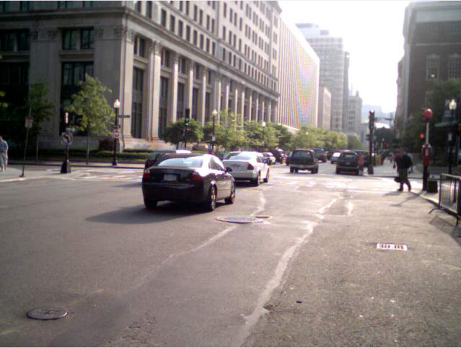
2.7 MATLAB example: inspect image properties
img = imread('C:\Program Files\
MATLAB\R2018a\toolbox
\matlab\demos\street2.jpg');
size(img)
class(img)
imshow(img)
ans = 480 640 3
ans = 'uint8'
So the image is 480 pixels tall, 640 pixels wide, and has full color information, Red, Green, and Blue (RGB) i.e 3
uint8 stands for unsigned 8‑bit integer.
Each pixel value in the image is stored as a whole number from 0 to 255 (2⁸ = 256 possible values).
For a color image, each channel (R, G, B) of every pixel is a uint8 number, where 0 = black (no intensity) and 255 = full intensity for that color.

Slide 6
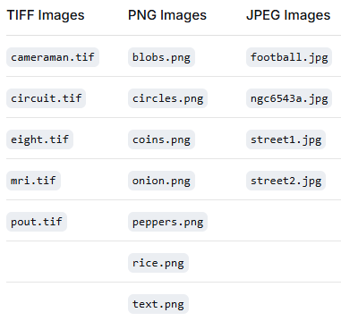

Slide 7

2.8 AI integration
Resolution matters in CNNs. If images are too small, disease patterns may be lost. If too large, computation becomes heavy.
2.9 Questions
What is the difference between spatial and intensity resolution?
How many levels exist in a 10-bit image?
2.10 Answers
Spatial resolution concerns image dimensions; intensity resolution concerns number of gray levels.
$2^{10}=1024$

Slide 8
3. Sampling and Quantization

Slide 9
3.1 Sampling
Sampling converts a continuous image into discrete spatial coordinates.
If sampling is poor, details are lost and aliasing may occur.
3.2 Quantization
Quantization converts continuous intensity values into a finite number of levels.
3.3 Combined digitization
Digitization = sampling + quantization.
3.4 Aliasing
Aliasing occurs when the sampling rate is too low, producing false patterns or jagged edges or wavy patterns.
is an effect that causes different signals or patterns to become indistinguishable from one another. It happens when a signal is sampled at a rate that is too low to capture its details accurately
Think of the classic wagon-wheel effect in old movies: the wheel appears to spin backward or freeze, even though the car is moving forward. That's aliasing.
In engineering, the rule is: To accurately capture a signal, you must sample it at least twice as fast as its highest frequency (Nyquist Theorem)
Anti-aliasing = The fix (blurring edges, adding a low-pass filter, or increasing resolution).

Slide 10
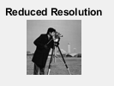
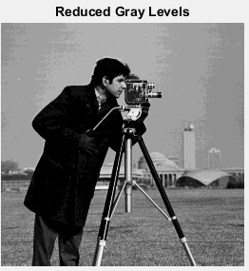
3.5 Worked example
Suppose a continuous signal is sampled too coarsely. A thin blood vessel in an image may disappear or appear broken. This is a practical consequence in medical imaging.
3.6 MATLAB example: reduce resolution
img = imread(' C:\Program Files\
MATLAB\R2018a\toolbox\
images\imdata\cameraman.tif');
small = imresize(img, 0.25);
imshow(small)
title('Reduced Resolution');
Quantization example:
img = imread(' C:\Program Files\
MATLAB\R2018a\toolbox\
images\imdata\cameraman.tif');
img4 = uint8(floor(double(img)/16)*16);
imshow(img4)
title('Reduced Gray Levels');

Slide 11
3.7 AI integration
Before CNN training, images are often resized to fixed dimensions such as 224×224. This is a form of sampling. Careless resizing may remove subtle disease patterns.
3.8 Questions
Define sampling.
Define quantization.
What is aliasing?
3.9 Answers
Sampling discretizes spatial coordinates.
Quantization discretizes intensity values.
Aliasing is distortion due to insufficient sampling.

Slide 12
4. Intensity Transformations and Histograms

Slide 13
4.1 Histogram
An image histogram shows the number of pixels at each gray level.
It helps us understand whether an image is dark, bright, low contrast, or high contrast.
4.2 Common intensity transformations
Negative transformation
Log transformation
Power-law transformation
Contrast stretching
Thresholding

Slide 14

4.3 Negative image
For a general image with gray levels from 0 to L−1, the negative transformation is: $s=L−1−r$
This inverts the intensity: dark pixels become bright, and bright pixels become dark.
Where r = Input pixel value (the original intensity of a pixel in the source image).
s = Output pixel value (the transformed intensity for that pixel in the resulting negative image).
L = Number of gray levels in the image.
Example: For 8-bit image
An 8-bit image has L=256 (gray levels 0 to 255). The formula becomes:
$s=255−r .$
If r=0 (black), then s=255 (white).
If r=255 (white), then s=0 (black).
If r=100 (medium gray), then s=155 (the opposite gray)
Purpose: This is useful when the background is dark and the object/details are white. A negative image flips the contrast, making white details easier to see against a dark background (or vice versa). It's a simple point-wise intensity transformation.

Slide 15

4.4 Log Transformation
$s=c⋅log⁡(1+r)$
r = Input pixel value (≥ 0, typically 0 to 255 for 8-bit)
s = Output pixel value
c = A scaling constant that determines the output range (e.g., $c=255/(log⁡(256))$​ for 8-bit images)
What it does
Expands dark regions (low r values) – small changes in dark pixels become more visible.
Compresses bright regions (high r values) – large differences in bright pixels are reduced.
Why use it?
To display images with a very wide dynamic range (e.g., Fourier spectrum, images with both deep shadows and bright highlights).
It mimics human visual response (which is roughly logarithmic).

Slide 16
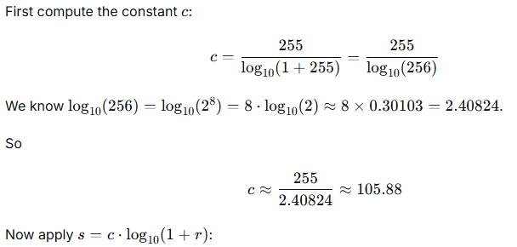
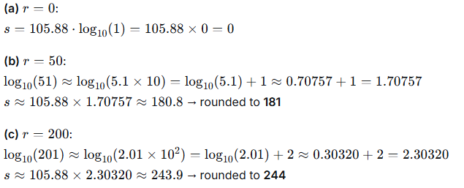

Example: An 8‑bit grayscale image has pixel values from 0 to 255. You apply the log transformation $s=c⋅log⁡10(1+r)$where $c=255/(log⁡(256))$​ so that an input of r=255 maps to s=255. What are the output values for (a) r=0 (black) (b) r=50 (dark gray) (c) r=200 (bright gray)?
Solution:
Interpretation:
Dark input (0) stays dark. Medium gray (50) becomes much brighter (181). A very bright input (200) becomes only slightly brighter (244). The dark regions are “stretched” while bright regions are “compressed”.

Slide 17
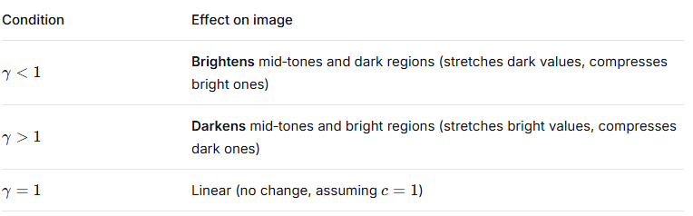

4.5 Power‑Law (Gamma) Transformation
$s=c.r^{γ}$
r = Input pixel value (normalized to [0,1] or original range)
s = Output pixel value
c = Scaling constant (usually c=1 if r is normalized to [0,1])
γ (gamma) = Exponent that controls the shape of the curve
Effects of γ (when r is normalized between 0 and 1)
Why use it?
Gamma correction – Many display devices (CRT, LCD) have a non‑linear response. Applying γ<1 pre‑corrects the image so it appears linear on the screen.
Image enhancement – Adjusting γ can reveal details in shadows (γ<1) or highlights (γ>1).

Slide 18
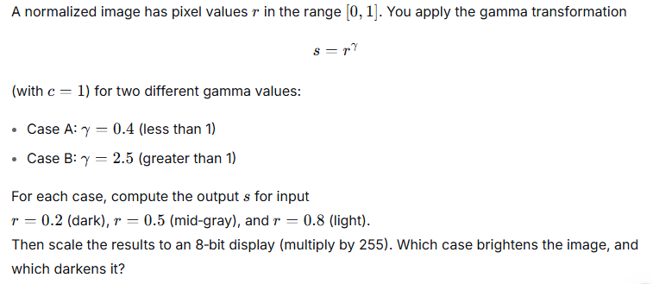
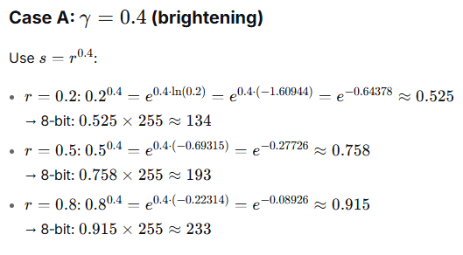
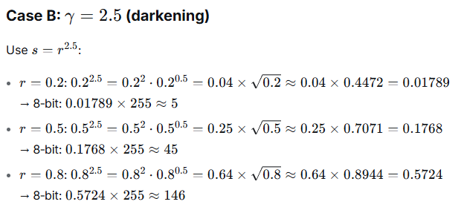
Example:
Solution

Slide 19
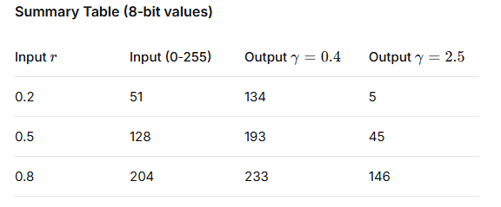
Conclusion:
γ=0.4<1 brightens the image (dark inputs become much brighter).
γ=2.5>1 darkens the image (all outputs are lower than the inputs, especially the dark regions).

Slide 20
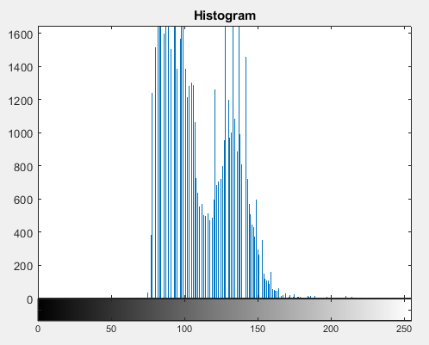
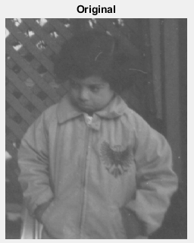
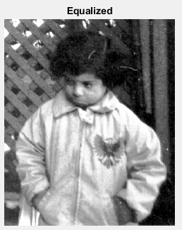
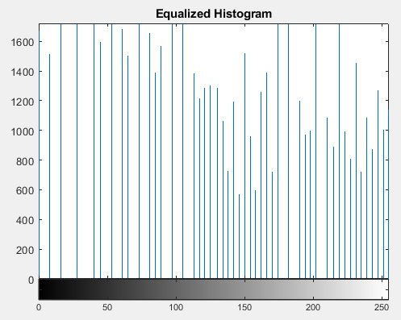
4.6 Contrast stretching
Expands narrow intensity range into a broader range.
4.7 MATLAB example: histogram and equalization
img = imread('C:\Program Files\
MATLAB\R2018a\toolbox\images\imdata\pout.tif'); figure; imshow(img); title('Original'); figure; imhist(img); title('Histogram'); eq = histeq(img); figure; imshow(eq); title('Equalized'); figure; imhist(eq); title('Equalized Histogram');

Slide 21

4.8 AI integration
Histogram normalization can reduce lighting variability before classification.
4.9 Questions
What does a histogram represent?
Write the negative transformation equation.
What is gamma correction?
4.10 Answers
Distribution of intensity values.
$s=255−r$for 8-bit.
Power-law transformation controlling brightness.

Slide 22
5. Histogram Equalization and Contrast Enhancement

Slide 23
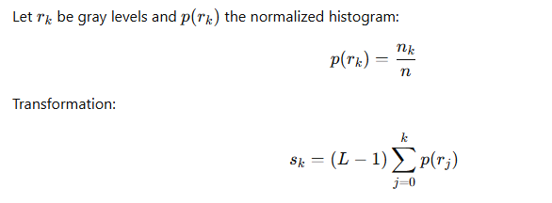
5.1 Motivation
Many medical and natural images have poor contrast. Histogram equalization enhances global contrast.
5.2 Principle
Histogram equalization uses the cumulative distribution function (CDF) to remap intensities.
5.3 Interpretation
If many pixels occupy a narrow intensity range, equalization spreads them out.

Slide 24
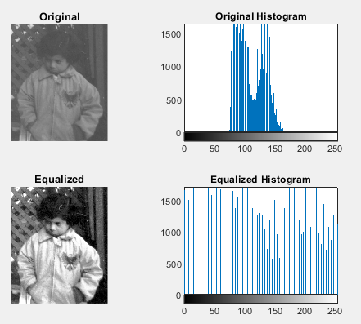
5.5 MATLAB example
img = imread('C:\Program Files\MATLAB\
R2018a\toolbox\images\imdata\pout.tif'); eq = histeq(img);
subplot(2,2,1); imshow(img); title('Original');
subplot(2,2,2); imhist(img); title('Original Histogram');
subplot(2,2,3); imshow(eq); title('Equalized');
subplot(2,2,4); imhist(eq); title('Equalized Histogram');
5.6 AI integration
Poor contrast can affect edge visibility and feature learning. Enhancement may improve classical ML and sometimes CNN robustness.
5.7 Exercise
Take a dark X-ray image and apply histogram equalization. Compare before and after histograms.

